Slide 1
Outstanding Team
Student’s Name
Institutional Affiliation
Date

Slide 2
CODE ORANGE (Internal Disaster Team)
Description of the Team
CODE ORANGE, (Internal Disaster Team), is a team made up of the following members:
CEO
COO (Leader)
Operation Supervisor (Respiratory)
Department Head (Respiratory, Safety)
Specific staff members from each related department as per the disaster plan.
The Internal Disaster Team was created to respond to internal problems that may jeopardize the safety of the staff, patient, or organization as a whole.
The disaster plan is further divided into sub-plans to be followed under each department involved in the safety plan.

Slide 3
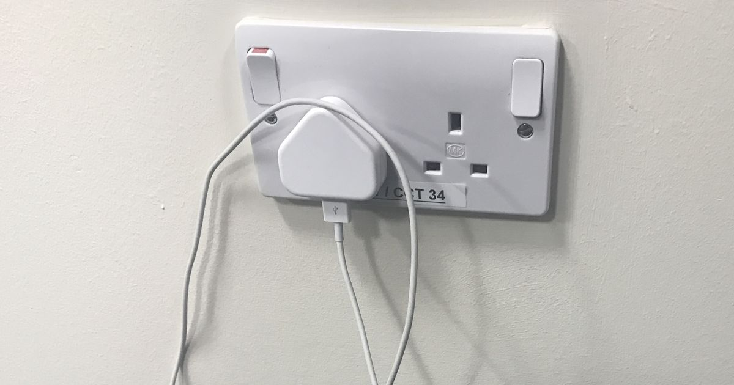
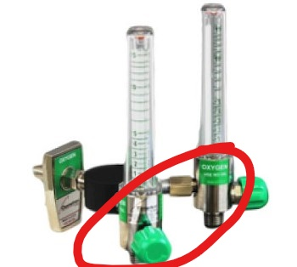
Cause for the Alarm
Smoke, and likelihood of fire outbreak in the Coronary Care Unit caused by:
Patient’s close relative using a smartphone charger not compatible with the hospital’s outlet.
Leaked Oxygen outlet due to the following:
Double Oxygen flow meters
Shut off valves causing additional weight
Additional weight due to the double oxygen flow meter as well as additional weight caused by shut off valves resulted to Oxygen leakage due to damage of rubber seals in the wall setup.
Incompatible charger also caused a spark and smoke hence increasing the chances of fire outbreak.

Slide 4
Cause for the Alarm Cont’d..
The smell of smoke was realized by the patient’s relative after he was unplugging charger.
He then informed the immediate nurse, who in turn informed the safety officer, activating the fire alarm.
Smoke and Oxygen leakage can potentially cause fire hence making it necessary for the safety officer to raise the alarm to the Internal Disaster Team.

Slide 5

Reasons why CODE ORANGE was Outstanding
After the alarm was raised by the safety officer, each department responded swiftly, following their sub-plans appropriately.
The smoke was assessed by staff with fire drill MCDs and they responded swiftly.
The rest of the disaster team arrived in less than 20 minutes.
COO assumed his leadership role and followed the disaster guidelines to ensure correct workflow of each team member in ensuring the disaster is prevented appropriately.
The Respiratory team, in conjunction with the fire marshal proceeded to shut off the gas supply to all rooms.
Patients were evacuated from vulnerable rooms in time.

Slide 6
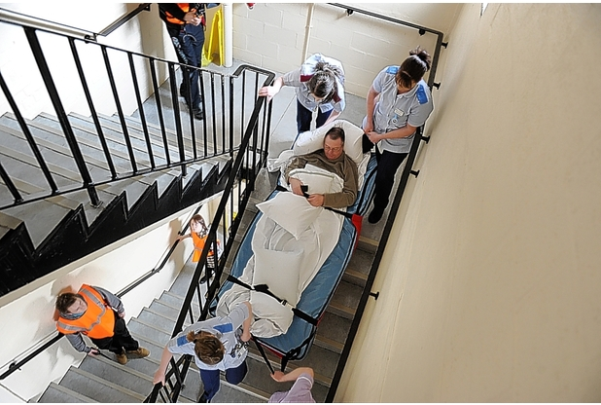

Reasons why CODE ORANGE was Outstanding
Patients were evacuated from vulnerable rooms in time using the appropriate evacuation drill.
To ensure patient safety, they were put in portable oxygen cylinders after relocation.
Conflict arose in the evacuation process as staff members were arguing about the cause of the fire, blaming each other for their negligence. As a leader, the COO stepped in immediately and reminded both staff about the importance of team work, especially during this disaster.
The staff were both assigned different duties by the Nursing director to ensure the evacuation is done smoothly.

Slide 7
Reasons why CODE ORANGE was Outstanding Cont’d…
Excellent teamwork resulted in successful evacuation of the patients, with 100% of the patients having no harm.
Amazing conflict resolution skills ensured the evacuation process is done smoothly despite conflicts arising between staff members.
Focus on patient safety was the core of the team and this enabled them to save all the patients in time.

Slide 8

Dimensions for the Team’s Success
Each team member knows what they bring to the table in relation to the disaster.
Reliable leadership from the COO hence effectively leading the team and employing his conflict resolution skills when necessary.
Experience and teamwork form each staff since they have been working together for a while.

Slide 9
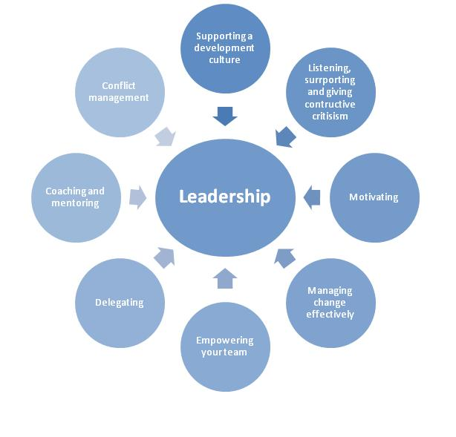
Leadership Skills
CODE ORANGE team is led by the COO, whose personality and leadership skills have significantly contributed to the team’s success.
The COO makes decisive decisions concerns the team’s response to disasters.
He has integrity and stands by his values thus enabling him make ethical choices for the team.
Excellent in conflict resolution. As he was able to settle the argument between the staff members and calm the tension that was building up.
Team-builder.
Teacher and mentor, especially in matters related to disaster response.

Slide 10
Reflections on what other teams can implement from the CODE ORANGE Team
Other teams can implement several approaches used in the team to ensure success including the following:
Time management, especially when a disaster is looming.
Teamwork to ensure smooth workflow in the team’s endeavors.
Leadership skills to ensure the team is under the required management.
Issuing clear instructions to each team member to ensure they all know their roles as part of the team.

Slide 11
Additional things CODE ORANGE could do differently / additionally
Not all teams are perfect and CODE ORANGE is no exception. The team could have done the following things differently or in addition to their duties;
Avoiding blame game in the team, especially during disasters to avoid unnecessary conflicts.
Educate each family member or close relative visiting patients on appropriate safety measures, including charging phones with unreliable chargers inside the patient’s room.

Slide 12
Conclusion
In summary, CODE ORANGE team was successful in responding to the emergency raised by the hospital safety officer, thanks to the teamwork and leadership skills displayed by team members.
Each member of CODE ORANGE knew their roles and this contributed to the smooth flow of work and success of the entire process.
The team should ensure each family member or close relatives visiting patients inside their rooms understand appropriate safety measures.

